Slide 1
The Data Link Layer Chapter 3
Data Link Layer Design Issues
Error Detection and Correction
Elementary Data Link Protocols
Sliding Window Protocols
Example Data Link Protocols

Slide 2
The Data Link Layer
Responsible for delivering frames of information over a single link
Handles transmission errors and regulates the flow of data
Application
Transport
Network
Link
Physical

Slide 3
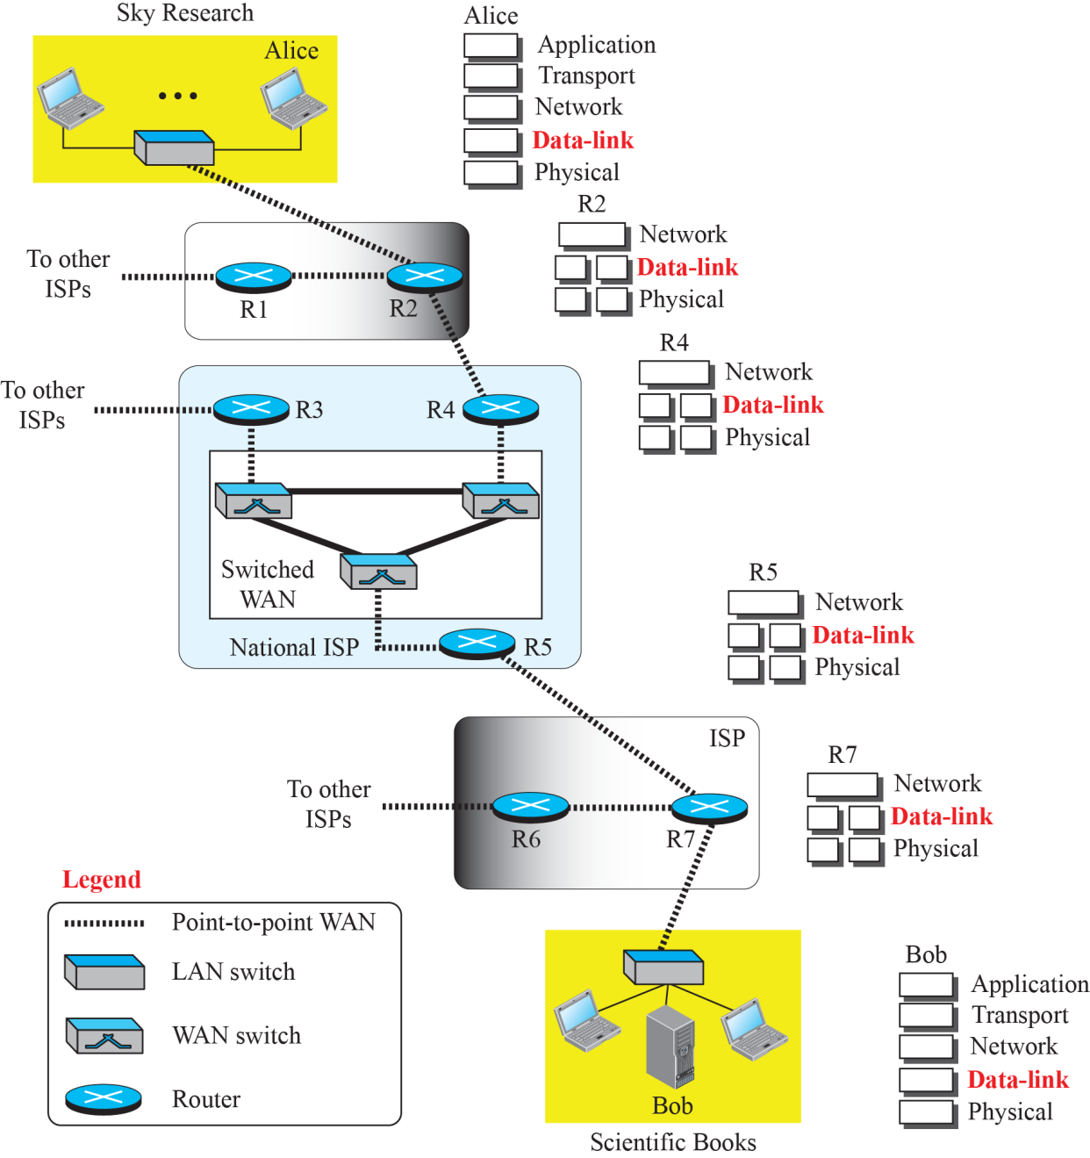
Communication at the data link layer

Slide 4
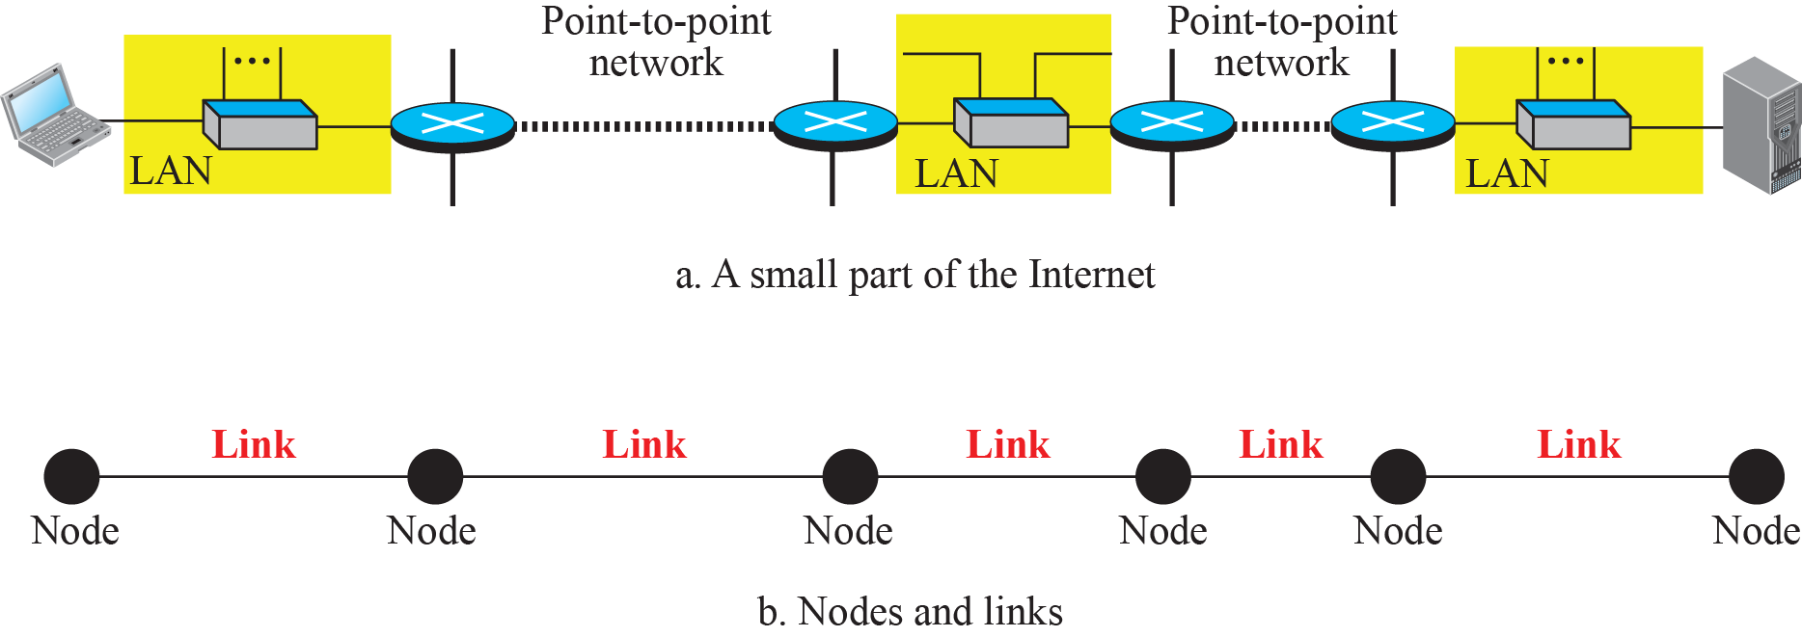
Nodes and Links
Notes:
A data unit from one point in the Internet needs to pass through many networks (LANs and WANs) to reach another point. Theses LANs and WANs are connected by routers.
It is customary to refer to the two end hosts and the routers as nodes and the networks in between as links.

Slide 5
Two Categories of Links
A point-to-point link uses the whole capacity of the medium.
dedicated to the two devices
E.g., when two friends use the traditional home phones to chat, they are using a point-to-point link;
A broadcast link uses only part of the capacity of the link.
shared between several pairs of devices.
E.g., when the same two friends use their cellular phones, they are using a broadcast link (the air is shared among many cell phone users).

Slide 6
Two Sublayers of the Data Link Layer
Data Link Control (DLC) sublayer deals with all issues common to both point-to-point and broadcast links.
Media Access Control (MAC) sublayer deals only with issues specific to broadcast links.

Slide 7
Data Link Layer Design Issues
Frames »
Possible services »
Framing methods »
Error control »
Flow control »

Slide 8
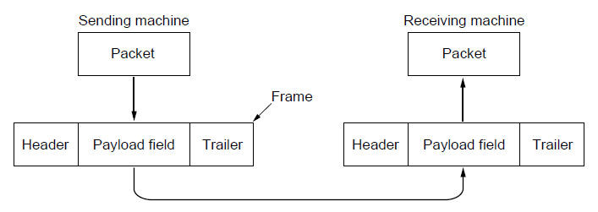
Frames
Link layer accepts packets from the network layer, and encapsulates them into frames that it sends using the physical layer; reception is the opposite process
Network
Link
Virtual data path
Physical
Actual data path
Reason for encapsulation and decapsulation:
- the link-layer addresses are normally different
- each link may be using a different protocol with a different frame format.
Notes:
Assume a person needs to travel from her home to her friend’s home in another city.
The traveller can use three transportation tools. She can take a taxi to go to the train station in her own city, then travel on the train from her own city to the city where her friend lives, and finally reach her friend’s home using another taxi. Here we have a source node, a destination node, and two intermediate nodes.
The traveller needs to get into the taxi at the source node, get out of the taxi and get into the train at the first intermediate node (train station in the city where she lives), get out of the train and get into another taxi at the second intermediate node (train station in the city where her friend lives), and finally get out of the taxi when she arrives at her destination.
A kind of encapsulation occurs at the source node, encapsulation and decapsulation occur at the intermediate nodes, and decapsulation occurs at the destination node.
Our traveller is the same, but she uses three transporting tools to reach the destination.

Slide 9
Possible Services
Unacknowledged connectionless service
Frame is sent with no connection / error recovery
Ethernet is example
Acknowledged connectionless service
Frame is sent with retransmissions if needed
Example is 802.11
Acknowledged connection-oriented service
Connection is set up; rare

Slide 10
Framing Methods
Byte count »
Flag bytes with byte stuffing »
Flag bits with bit stuffing »
Physical layer coding violations
Use non-data symbol to indicate frame

Slide 11
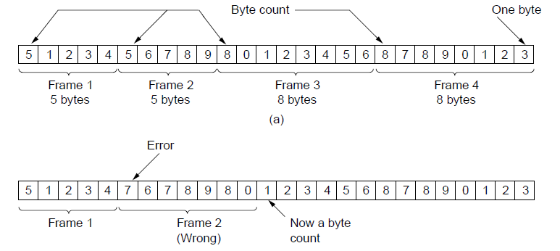
Framing – Byte count
Frame begins with a count of the number of bytes in it
Simple, but difficult to resynchronize after an error
Expected
case
Error
case

Slide 12
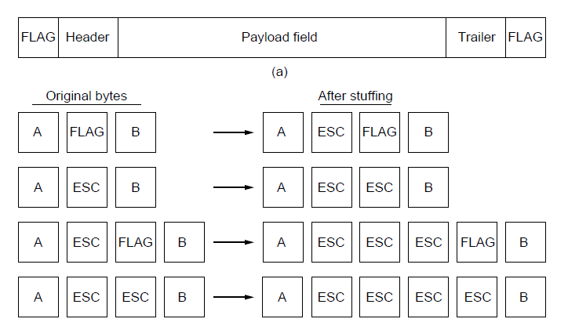
Framing – Byte stuffing
Special flag bytes delimit frames; occurrences of flags in the data must be stuffed (escaped)
Longer, but easy to resynchronize after error
Frame
format
Need to escape extra ESCAPE bytes too!
Stuffing
examples

Slide 13
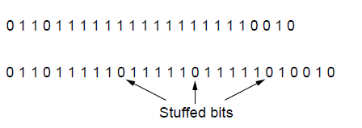
Framing – Bit stuffing
Stuffing done at the bit level:
Frame flag has six consecutive 1s (not shown)
On transmit, after five 1s in the data, a 0 is added
On receive, a 0 after five 1s is deleted
Data bits
Transmitted bits
with stuffing

Slide 14
Error Control
Error control repairs frames that are received in error
Requires errors to be detected at the receiver
Typically retransmit the unacknowledged frames
Timer protects against lost acknowledgements
Detecting errors and retransmissions are next topics.
Notes:
We’ll get to this later in the chapter (error detection/correction, and elementary data link protocols)

Slide 15
Flow Control
Prevents a fast sender from out-pacing a slow receiver
Receiver gives feedback on the data it can accept
Rare in the Link layer as NICs run at “wire speed”
Receiver can take data as fast as it can be sent
Flow control is a topic in the Link and Transport layers.
Feedback-based VS. Rate-based
Notes:
We’ll get to this later in the chapter (sliding window protocol) but note that flow control is mostly the responsibility of the Transport layer in practice (e.g., TCP)

Slide 16
The Data Link Layer Chapter 3
Data Link Layer Design Issues
Error Detection and Correction
Elementary Data Link Protocols
Sliding Window Protocols
Example Data Link Protocols

Slide 17
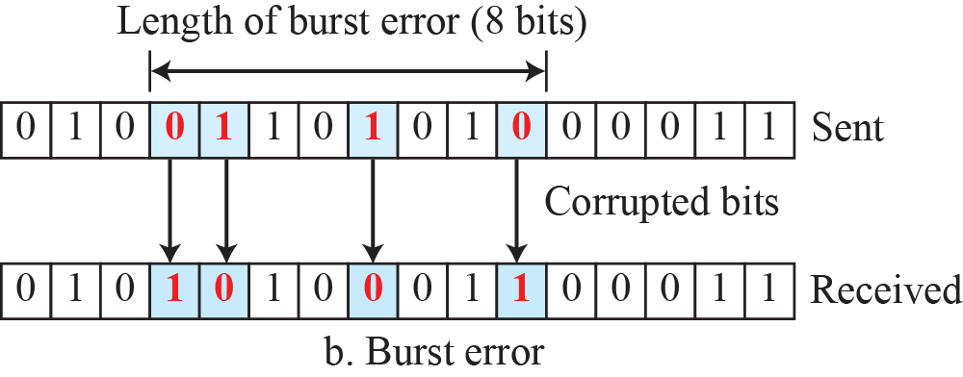
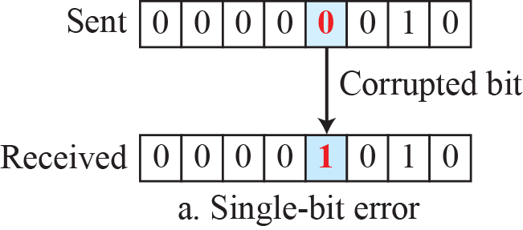
Type of Errors
Single-bit error means that only 1 bit of a given data unit (such as a byte, character, or packet) is changed from 1 to 0 or from 0 to 1.
Burst error means that 2 or more bits in the data unit have changed from 1 to 0 or from 0 to 1.

Slide 18
Error Detection and Correction
Error codes add structured redundancy to data so errors can be either detected, or corrected.
The correction of errors is more difficult than the detection.
In error detection, we are only looking to see if any error has occurred. The answer is a simple yes or no. We are not even interested in the number of corrupted bits. A single-bit error is the same for us as a burst error.
In error correction, we need to know the exact number of bits that are corrupted and, more importantly, their location in the message.

Slide 19
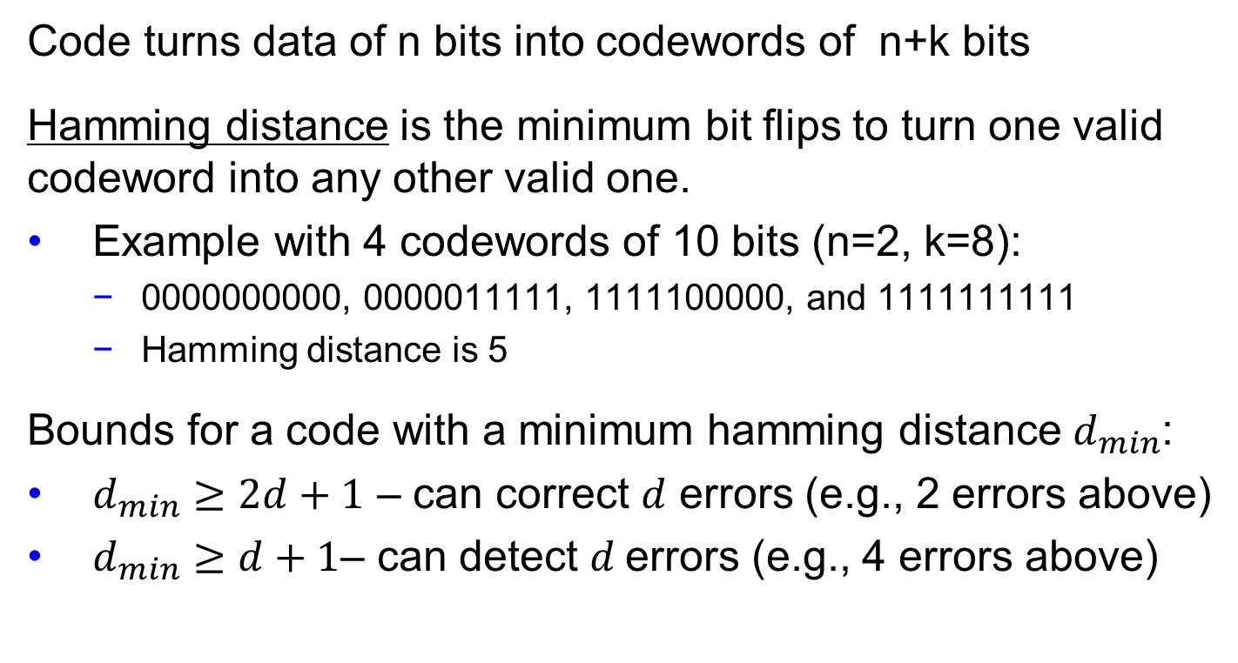
Error Bounds – Hamming distance
Code turns data of n bits into codewords of n+k bits
Hamming distance is the minimum bit flips to turn one valid codeword into any other valid one.
Example with 4 codewords of 10 bits (n=2, k=8):
0000000000, 0000011111, 1111100000, and 1111111111
Hamming distance is 5
Bounds for a code with a minimum hamming distance $d_{min}$:
$d_{min}≥2d+1$ – can correct $d$ errors (e.g., 2 errors above)
$d_{min}≥d+1$– can detect $d$errors (e.g., 4 errors above)
Notes:
Why can a code with distance d+1 detect up to d errors? Because errors are detected by receiving invalid codewords (like 0101010101 for the example). If there are d+1 or more errors then one valid codeword may be turned into another valid codeword and there is no way to detect that an error has occurred.
Why can a code with distance 2d+1 detect up to d errors? Because errors are corrected by mapping a received invalid codeword to the nearest valid codeword, i.e., the one that can be reached with the fewest bit flips. If there are more than d bit flips, then the received codeword may be closer to another valid codeword than the codeword that was sent. For example, sending 0000000000 with 2 flips might give 1100000000 which is closest to 0000000000, correcting the error. But with 3 flips 1110000000 might be received, which is closest to 1111100000, which is still an error.

Slide 20
Minimum Hamming distance
Find the minimum Hamming distance of the following coding scheme:
00000, 01011, 10101, 11110
d_{min} in this case is 3
This code can detect up to two errors,
and it can correct up to one error.

Slide 21
Linear Block Codes
Almost all block codes used today belong to a subset called linear block codes.
A linear block code is a code in which the result of XORing any codeword with any other codeword is a valid codeword.
E.g., the code schemes on the previous slides

Slide 22
Error Correction Codes
Retransmission of corrupted and lost packets is not useful for real-time multimedia transmission.
Forward Error Correction (FEC) is used to correct the error or reproduce the packet immediately.
Hamming codes »
Binary convolutional codes »
GSM mobile phone system, satellite communications
Reed-Solomon and Low-Density Parity Check codes
Mathematically complex, widely used in real systems
RS codes: DSL, data over cable, satellite communications, CDs, DVDs, and Blu-ray discs
LDPC codes: digital video broadcasting, 10Gbps Ethernet, power-line network, latest version of 802.11

Slide 23
Hamming Codes
Hamming codes provide for FEC using a “Block Parity”
Allows correction of single bit errors
This is accomplished by using more than one parity bit
Each computed on different combination of bits in the data

Slide 24
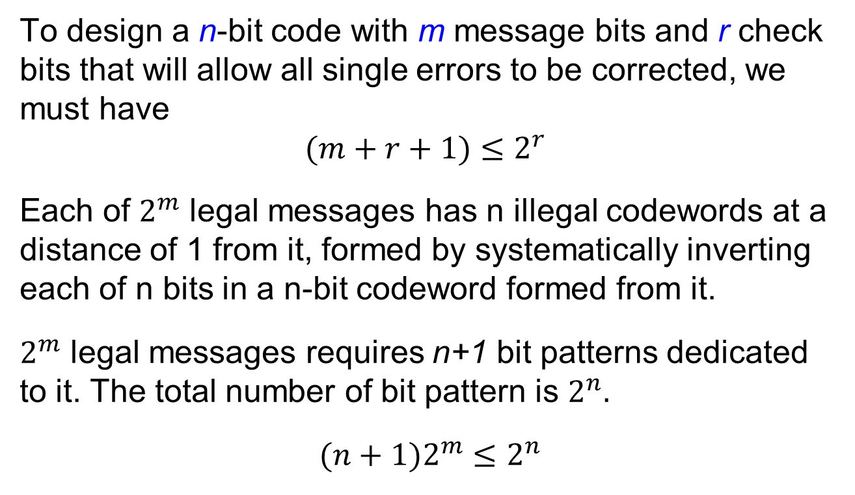
Single Error Correction
To design a n-bit code with m message bits and r check bits that will allow all single errors to be corrected, we must have
$$(m+r+1)≤2^{r}$$
Each of $2^{m}$ legal messages has n illegal codewords at a distance of 1 from it, formed by systematically inverting each of n bits in a n-bit codeword formed from it.
$2^{m}$ legal messages requires n+1 bit patterns dedicated to it. The total number of bit pattern is $2^{n}.$
$(n+1)2^{m}≤2^{n}$

Slide 25
Data and redundancy bits of Hamming Codes
Number of data bits m | Number of redundancy bits r | Total bits m + r
1 | 2 | 3
2 | 3 | 5
3 | 3 | 6
4 | 3 | 7
5 | 4 | 9
6 | 4 | 10
7 | 4 | 11

Slide 26
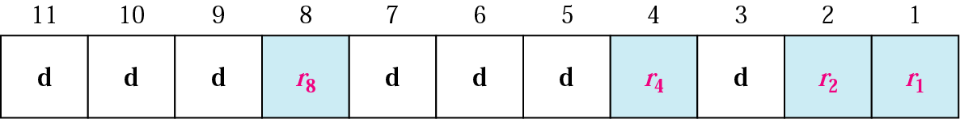
Positions of Redundancy Bits

Slide 27
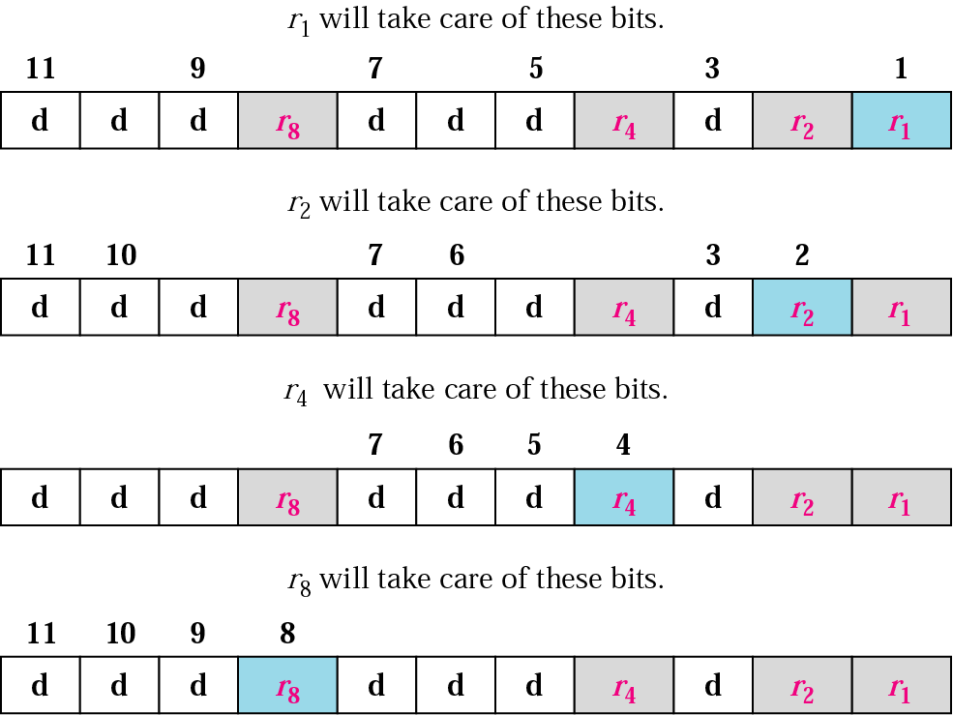
Redundancy Bits Calculation

Slide 28
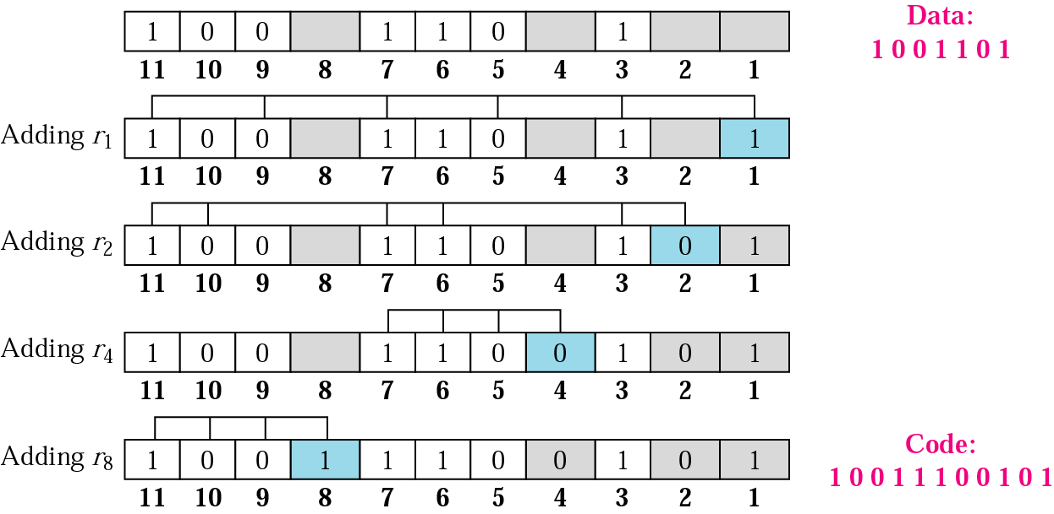
Example

Slide 29
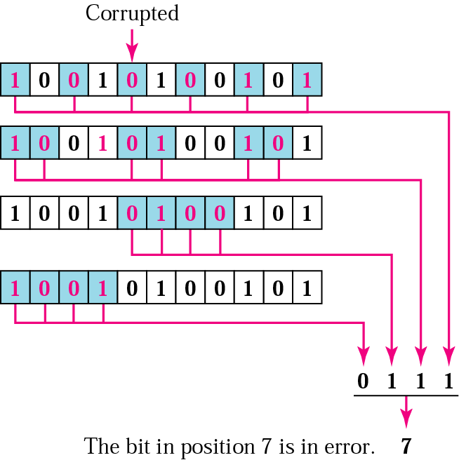
Error Correction using Hamming Code

Slide 30
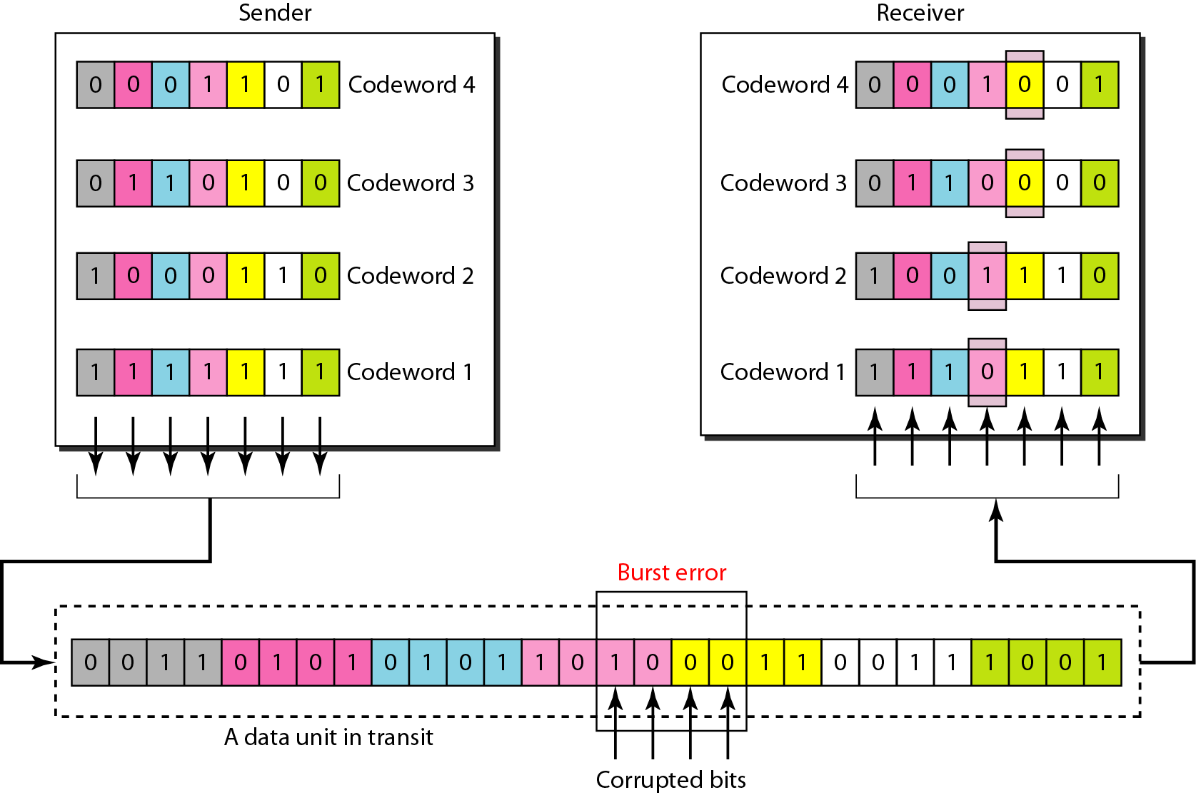
Burst error correction using Hamming code

Slide 31
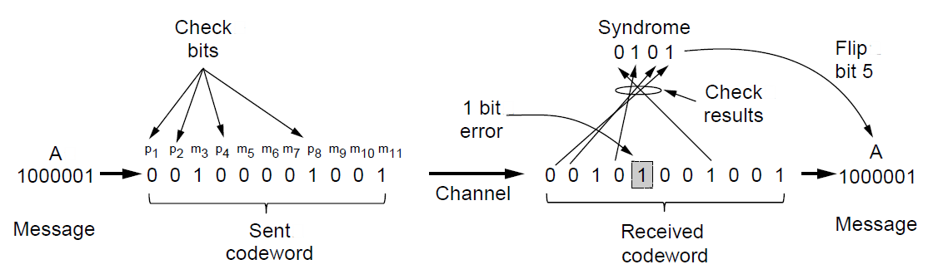
Summary of Hamming code
Hamming code gives a simple way to add check bits and correct up to a single bit error:
Check bits are parity over subsets of the codeword
Recomputing the parity sums (syndrome) gives the position of the error to flip, or 0 if there is no error
(11, 7) Hamming code adds 4 check bits and can correct 1 error

Slide 32
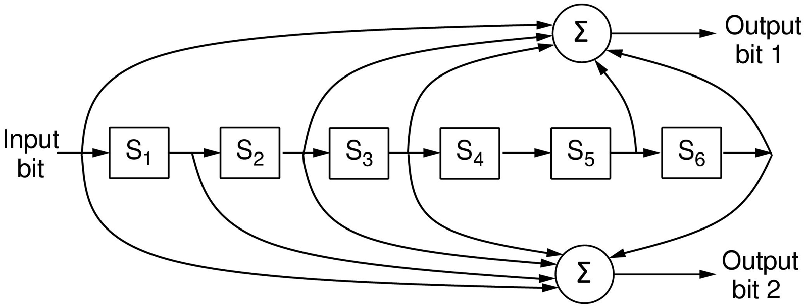
Error Correction – Convolutional codes
Operates on a stream of bits, keeping internal state
Output stream is a function of all preceding input bits
Bits are decoded with the Viterbi algorithm
… 1 1 1
…
0 1 1
1 0 1
Popular NASA binary convolutional code (rate = ½) used in 802.11

Slide 33
Error detection codes
Parity »
Checksums »
Cyclic redundancy codes »

Slide 34
Error Detection – Parity (1)
Parity bit is added as the modulo 2 sum of data bits
Equivalent to XOR; this is even parity
Ex: 1110000 → 11100001
Detection checks if the sum is wrong (an error)
Simple way to detect an odd number of errors
Ex: 1 error, 11100101; detected, sum is wrong
Ex: 3 errors, 11011001; detected sum is wrong
Ex: 2 errors, 11101101; not detected, sum is right!
Error can also be in the parity bit itself
Random errors are detected with probability ½

Slide 35
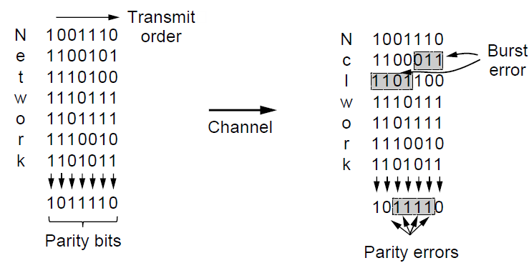
Error Detection – Parity (2)
Interleaving of N parity bits detects burst errors up to N
Each parity sum is made over non-adjacent bits
An even burst of up to N errors will not cause it to fail

Slide 36
Error Detection – Checksums
Checksum is an error-detecting technique that can be applied to a message of any length.
Checksum treats data as N-bit words and adds N check bits that are the modulo 2^{N} sum of the words
Ex: Internet 16-bit 1s complement checksum
Properties:
Improved error detection over parity bits
Detects bursts up to N errors
Detects random errors with probability 1-2^{N}
Vulnerable to systematic errors, e.g., added zeros

Slide 37
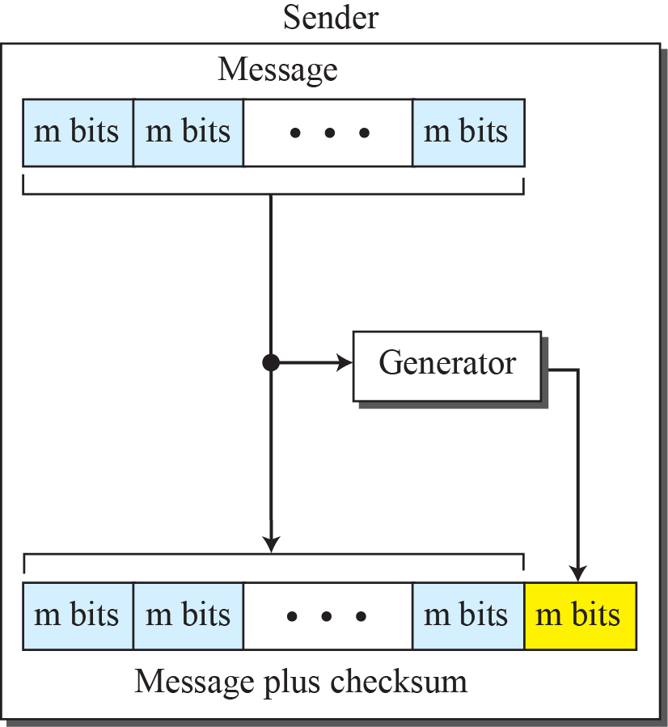
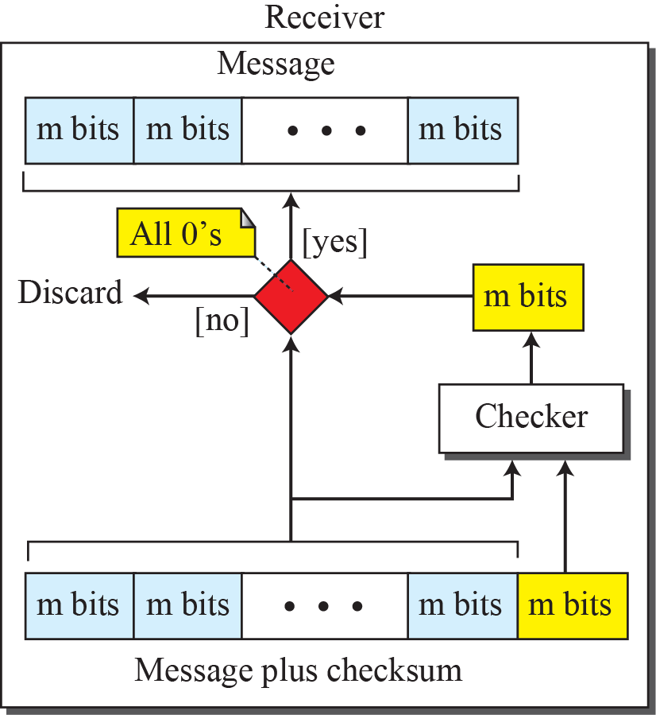
Checksum

Slide 38
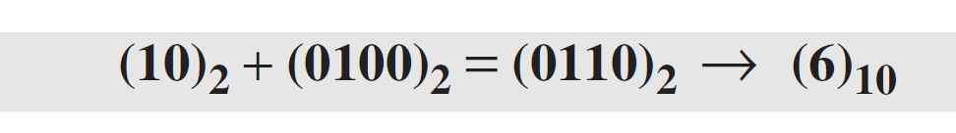
Checksum Example
Suppose the message is a list of five 4-bit numbers that we want to send to a destination. In addition to sending these numbers, we send the sum of the numbers.
For example, if the set of numbers is (7, 11, 12, 0, 6), we send (7, 11, 12, 0, 6, 36), where 36 is the sum of the original numbers.
The decimal number 36 in binary is (100100)2. To change it to a 4-bit number we add the extra leftmost bit to the right four bits as shown below.

Slide 39
Checksum Example (cont.)
The sender adds all five numbers in one’s complement to get the sum = 6. The sender then complements the result to get the checksum = 9, which is 15 − 6.
Note that 6 = (0110)2 and 9 = (1001)2; they are complements of each other.
The sender sends the five data numbers and the checksum (7, 11, 12, 0, 6, 9).
If there is no corruption in transmission, the receiver receives (7, 11, 12, 0, 6, 9) and adds them in one’s complement to get 15.

Slide 40
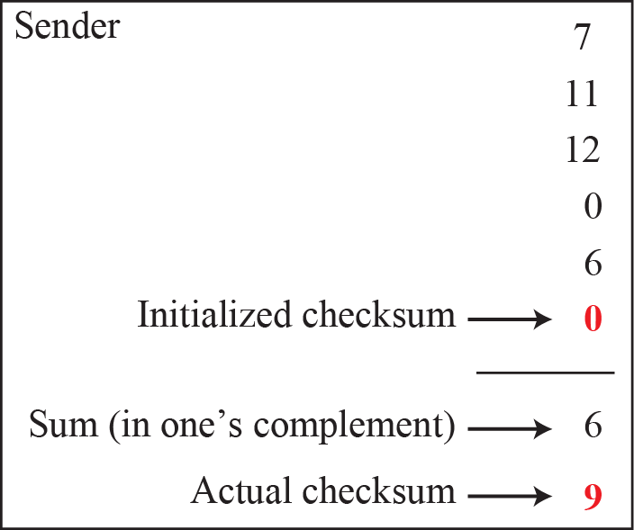
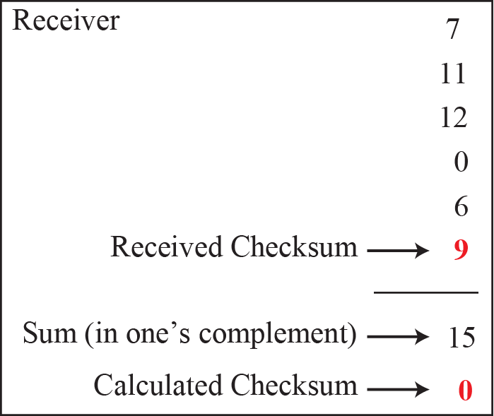
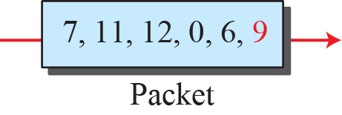
Calculation procedure of the previous example

Slide 41
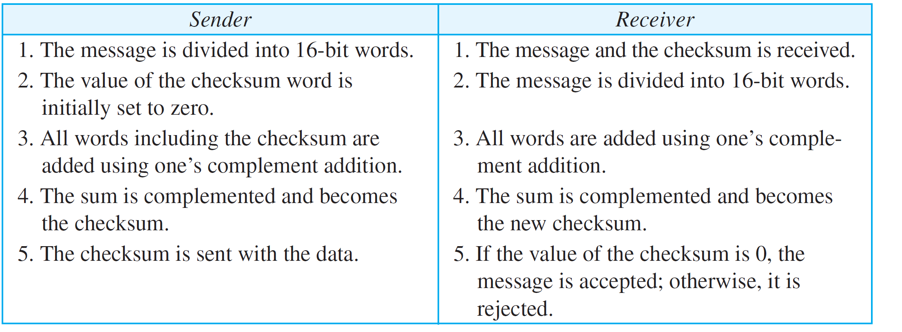
Procedure to calculate the traditional checksum

Slide 42
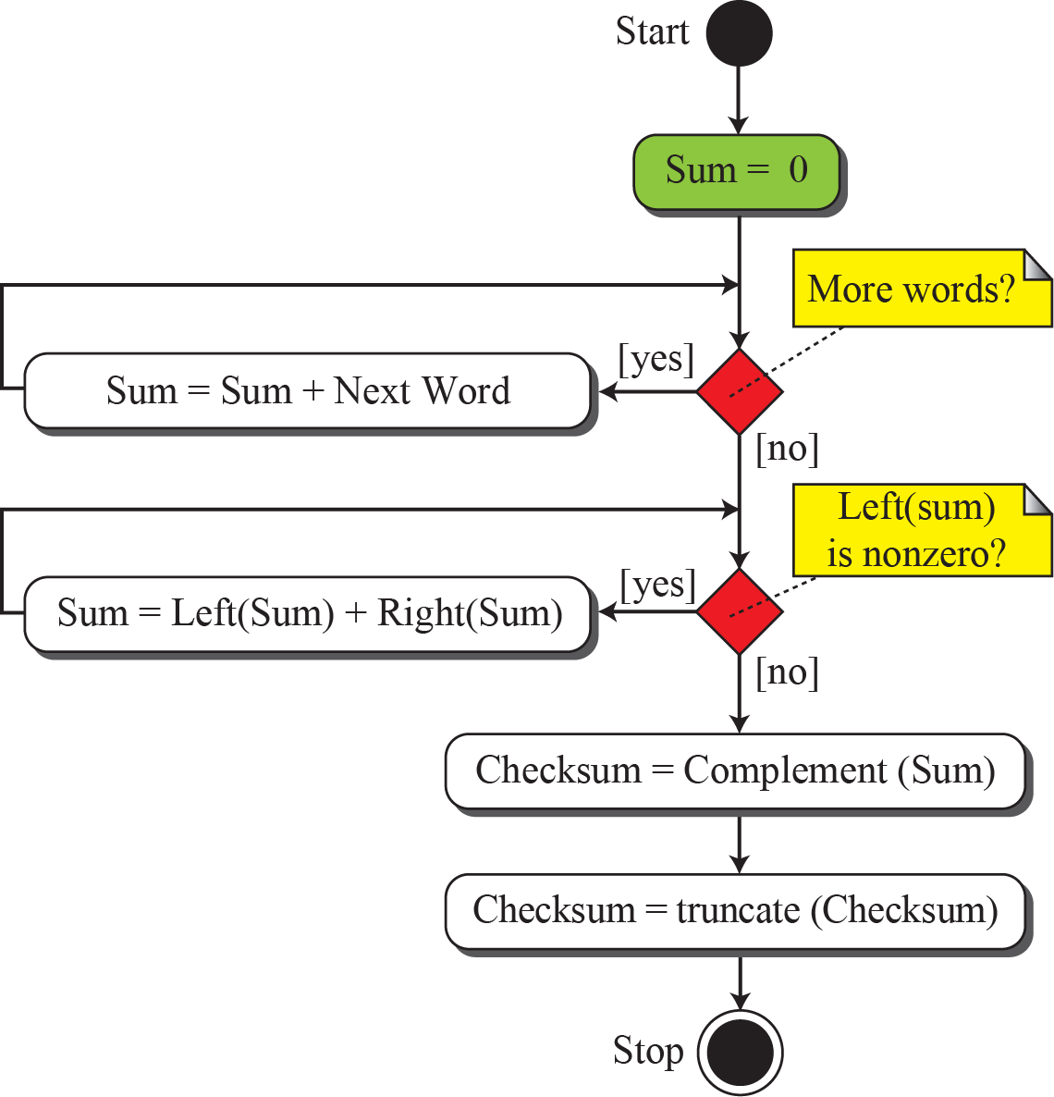
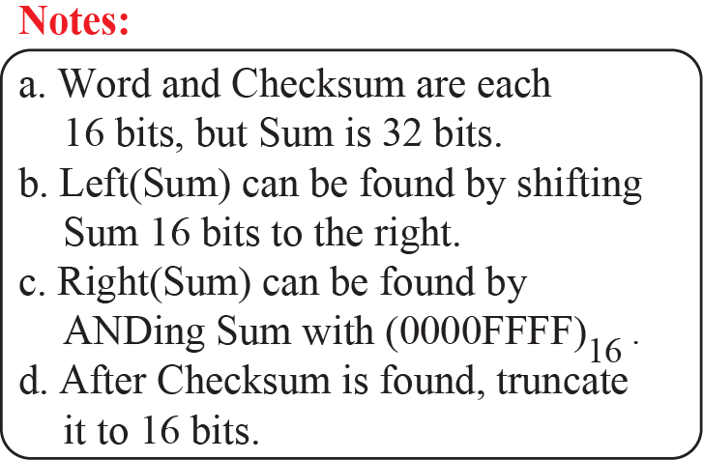
Algorithm to calculate the traditional checksum

Slide 43
Problems of the traditional checksum calculation
If two 16-bit items are transposed in transmission, the checksum cannot catch this error.
The reason is that the traditional checksum is not weighted: it treats each data item equally.
In other words, the order of data items is immaterial to the calculation.
Several approaches have been used to prevent this problem, such as Fletcher and Adler.

Slide 44
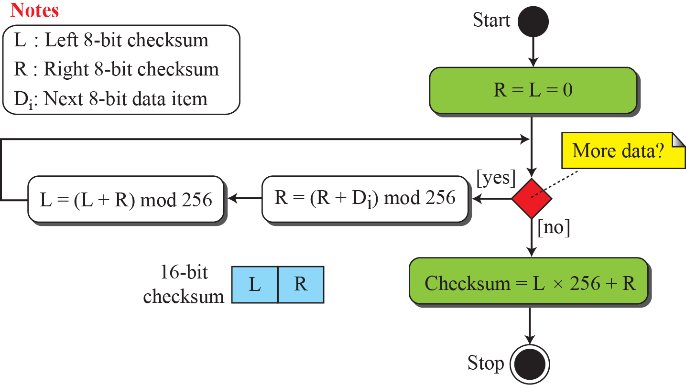
Algorithm to calculate an 8-bit Fletcher checksum

Slide 45
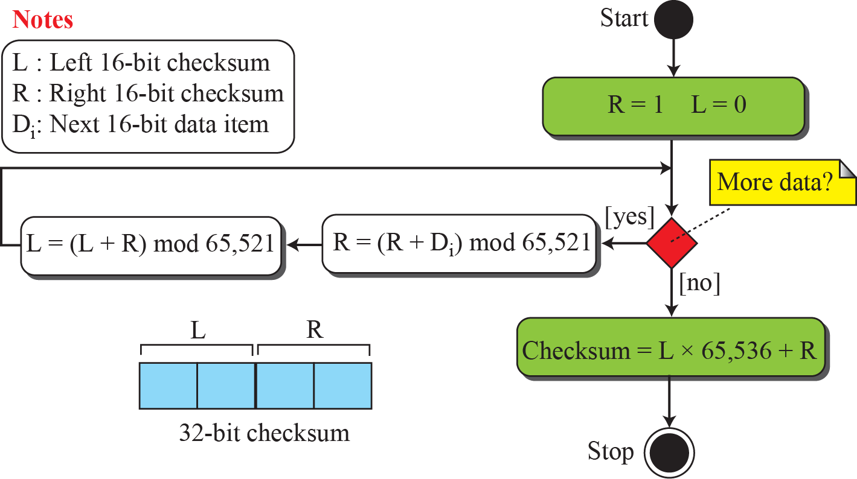
Algorithm to calculate an Adler checksum

Slide 46
Cyclic codes
Cyclic codes are special linear block codes with one extra property.
In a cyclic code, if a codeword is cyclically shifted (rotated), the result is another codeword.
For example, if 1011000 is a codeword and we cyclically left-shift, then 0110001 is also a codeword.
Cyclic Redundancy Check (CRC), which is used in networks such as LANs and WANs. It adds bits so that transmitted frame viewed as a polynomial is evenly divisible by a generator polynomial.

Slide 47
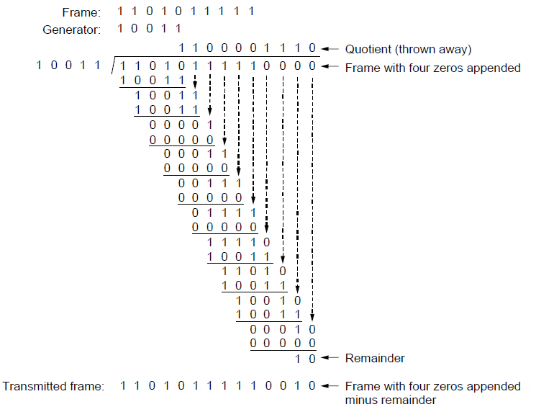
Error Detection – CRCs
Start by adding 0s to frame and try dividing
Offset by any reminder to make it evenly divisible

Slide 48
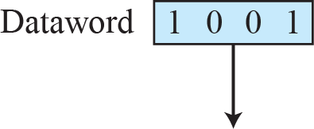
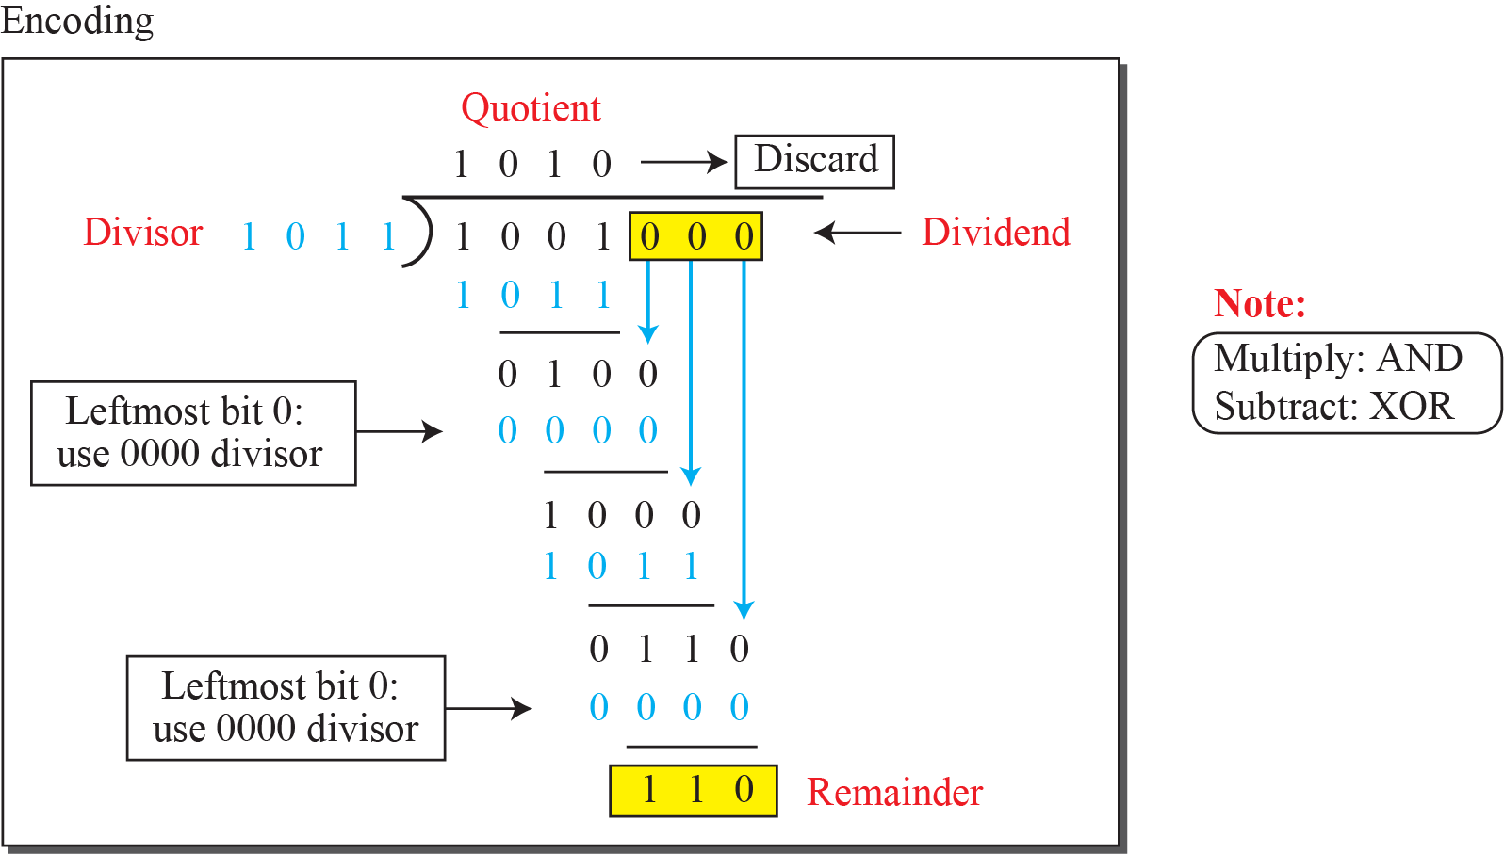
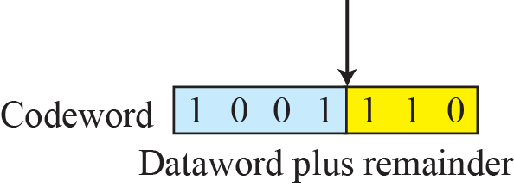
Division in CRC encoder

Slide 49
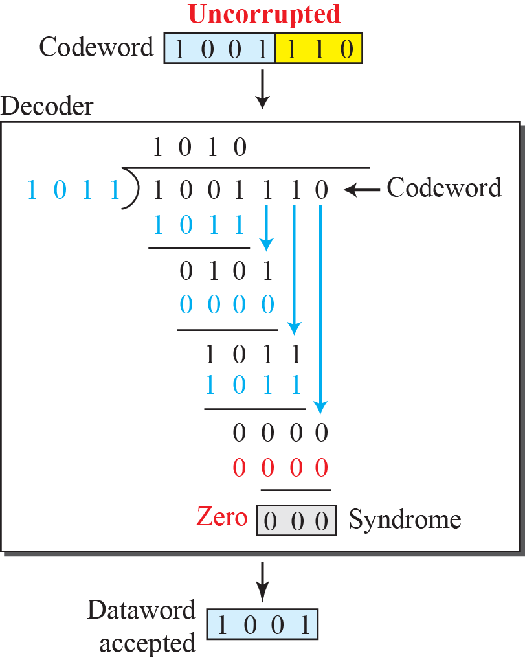
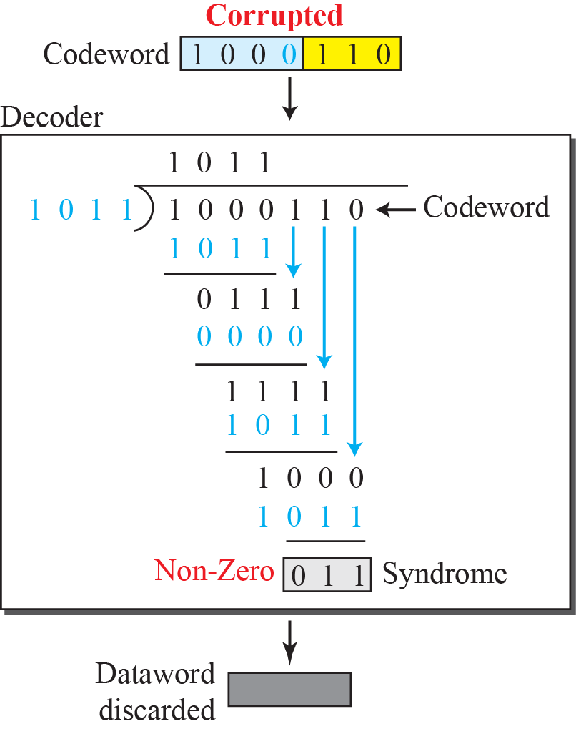
Division in the CRC decoder for two cases

Slide 50
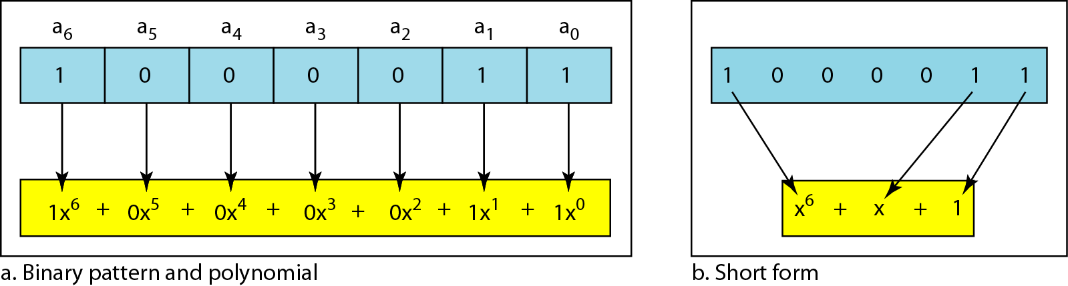
A polynomial to represent a binary word

Slide 51
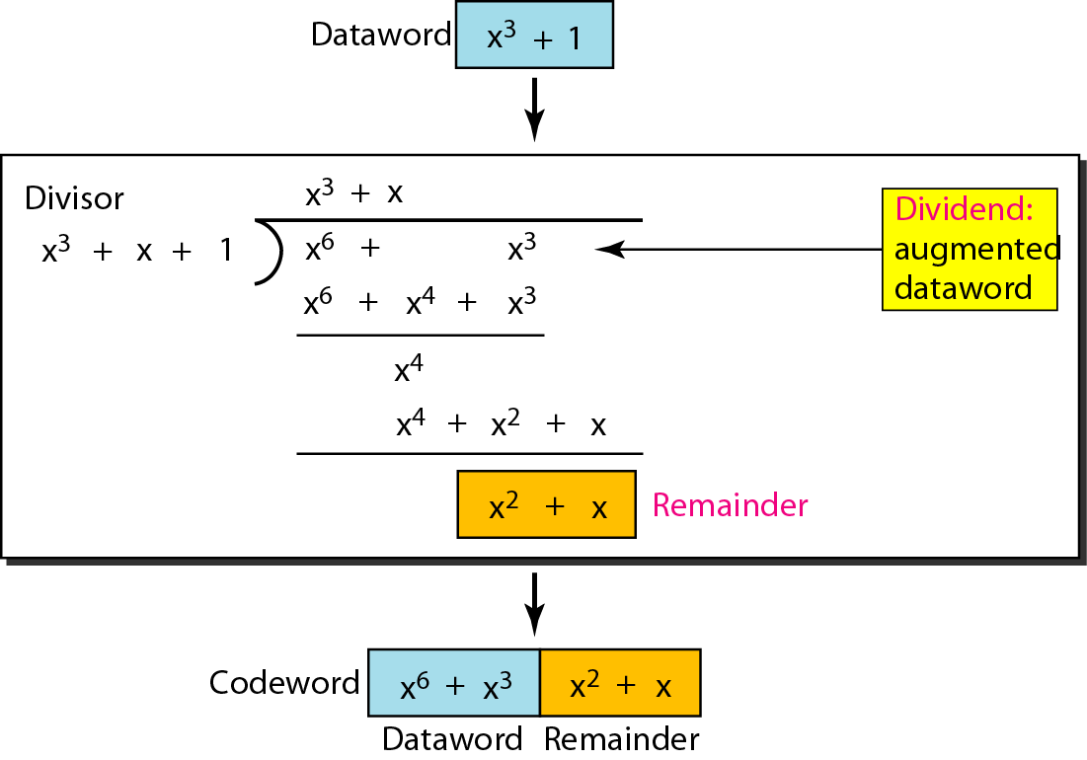
CRC division using polynomials

Slide 52
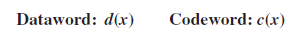
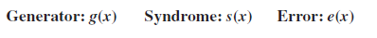
Performance
In a cyclic code, those e(x) errors that are divisible by g(x) are not caught.
If the generator has more than one term and the coefficient of x⁰ is 1, all single errors can be caught.
A generator that contains a factor of x + 1 can detect all odd-numbered errors.

Slide 53
Performance (contd.)
All burst errors with L ≤ r will be detected.
All burst errors with L = r + 1 will be detected with probability 1 – (1/2)^{r–1}.
All burst errors with L > r + 1 will be detected with probability 1 – (1/2)^{r}.

Slide 54
Example
Which of the following g(x) values guarantees that a single-bit error is caught? For each case, what is the error that cannot be caught?
a. x + 1 b. x³ c. 1
Solution
a. No x^{i} can be divisible by x + 1. in other words, x^{i} /(x + 1) always has a remainder. Any single-bit error can be caught.
b. If i is equal to or greater than 3, x^{i} is divisible by g(x). The remainder of x^{i} /x³ is zero. All single-bit errors in positions 1 to 3 are caught.
c. All values of i make x^{i} divisible by g(x). No single-bit error can be caught. This g(x) is useless.

Slide 55
Properties of Good Polynomials
A good polynomial generator needs to have the following characteristics:
It should have at least two terms.
The coefficient of the term x⁰ should be 1.
It should have the factor x + 1.

Slide 56
CRC: a good candidate for many networks
Based on standard polynomials:
Ex: Ethernet 32-bit CRC is defined by:
Computed with simple shift/XOR circuits
Stronger detection than checksums:
very good performance in detecting single-bit errors, double errors, an odd number of errors, and burst errors.
Not vulnerable to systematic errors

Slide 57
Elementary Data Link Protocols
Link layer environment »
Utopian Simplex Protocol »
Stop-and-Wait Protocol for Error-free channel »
Stop-and-Wait Protocol for Noisy channel »

Slide 58
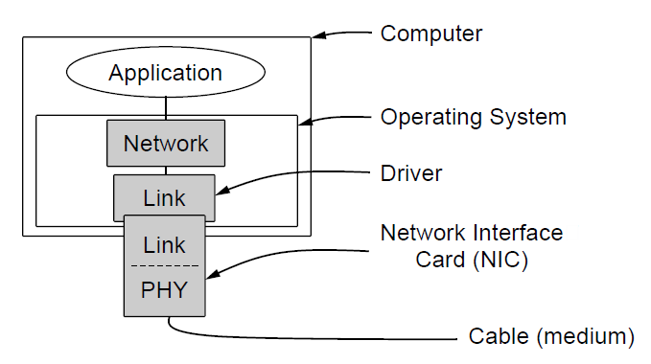
Link layer environment (1)
Commonly implemented as NICs and OS drivers; network layer (IP) is often OS software

Slide 59
Link layer environment (2)
Link layer protocol implementations use library functions
See code (protocol.h) for more details
Group | Library Function | Description
Network layer | from_network_layer(&packet) to_network_layer(&packet) enable_network_layer() disable_network_layer() | Take a packet from network layer to send Deliver a received packet to network layer Let network cause “ready” events Prevent network “ready” events
Physical layer | from_physical_layer(&frame) to_physical_layer(&frame) | Get an incoming frame from physical layer Pass an outgoing frame to physical layer
Events & timers | wait_for_event(&event) start_timer(seq_nr) stop_timer(seq_nr) start_ack_timer() stop_ack_timer() | Wait for a packet / frame / timer event Start a countdown timer running Stop a countdown timer from running Start the ACK countdown timer Stop the ACK countdown timer

Slide 60
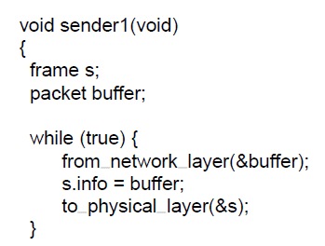
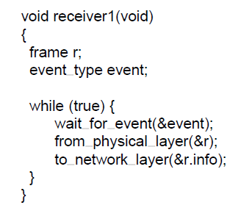
Utopian Simplex Protocol (1)
An optimistic protocol (p1) to get us started
Assumes no errors, and receiver as fast as sender
Considers one-way data transfer
That’s it, no error or flow control …
This is essentially what Ethernet does – just blast packets and receive as quickly as possible
}
Sender loops blasting frames
Receiver loops eating frames

Slide 61
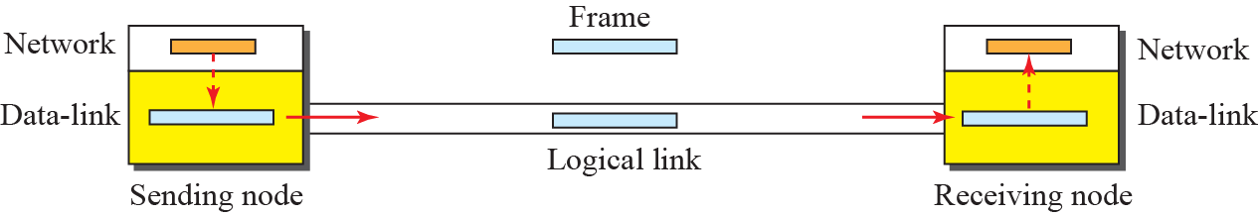
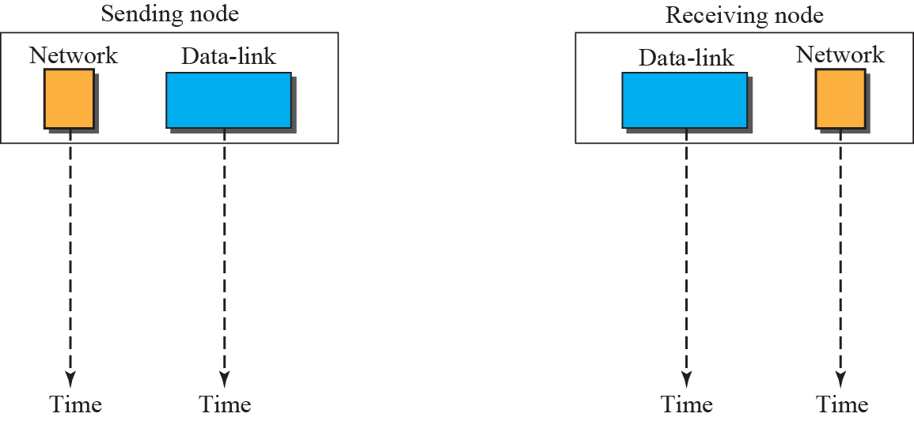

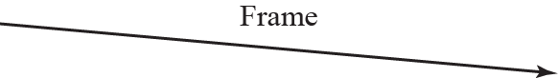
Utopian Simplex Protocol (2)

Slide 62
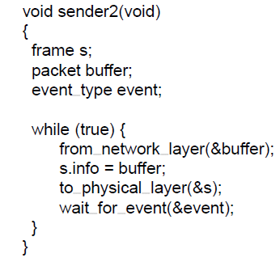
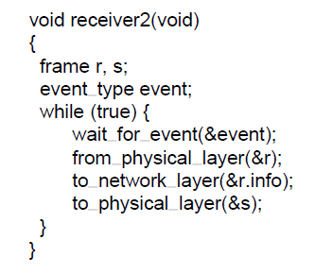
Stop-and-Wait – Error-free channel
Protocol (p2) ensures sender can’t outpace receiver:
Receiver returns a dummy frame (ack) when ready
Only one frame out at a time – called stop-and-wait
We added flow control!
Sender waits to for ack after passing frame to physical layer
Receiver sends ack after passing frame to network layer
Notes:
This is an intermediate protocol in which we’ve dealt with one issue (flow control) but not another (error control). It is instructive, but does not represent any real protocol (as it will deadlock if there are errors).

Slide 63
Stop-and-Wait – Noisy channel (1)
ARQ (Automatic Repeat reQuest) adds error control
ARQ is also called PAR (Positive Acknowledgement with Retransmission)
Receiver acks frames that are correctly delivered
Sender sets timer and resends frame if no ack)
For correctness, frames and acks must be numbered
Else receiver can’t tell retransmission (due to lost ack or early timer) from new frame
For stop-and-wait, 2 numbers (1 bit) are sufficient

Slide 64
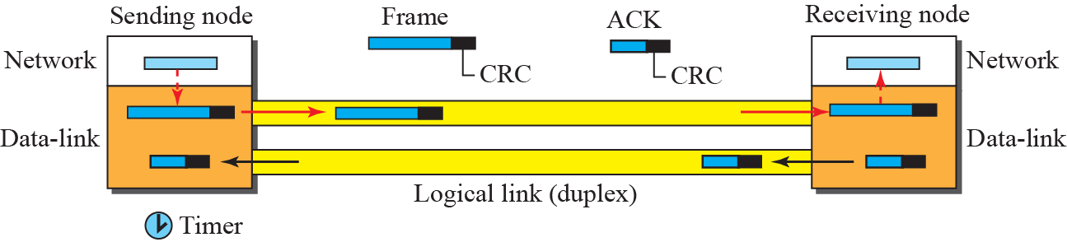
Stop-and-Wait – Noisy channel (2)

Slide 65
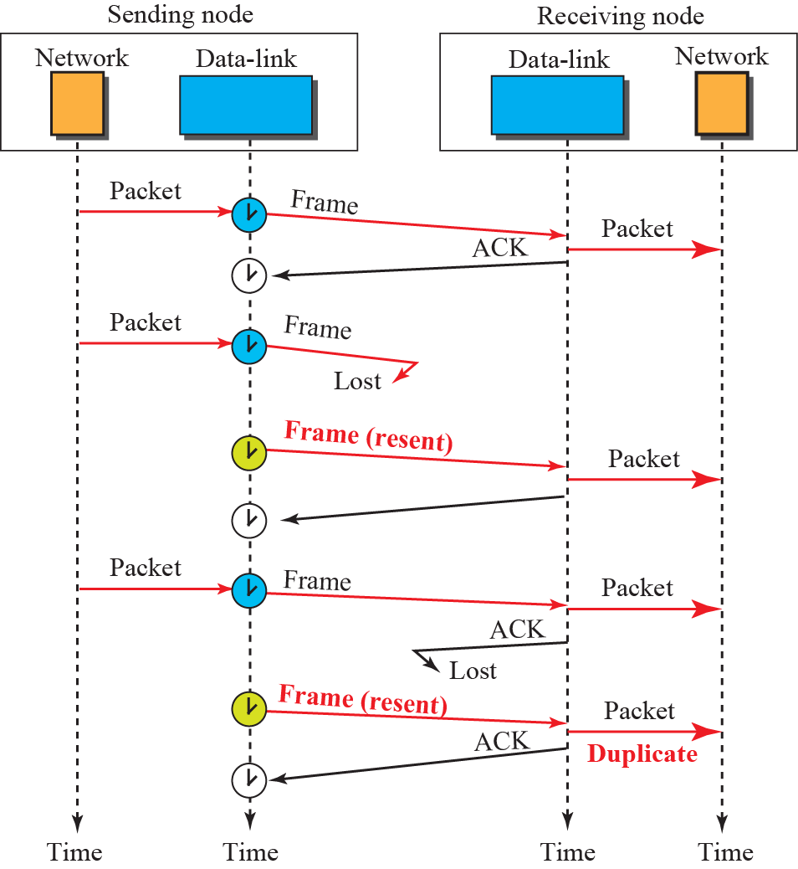
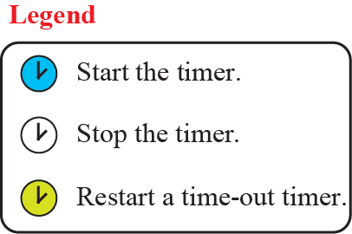

Stop-and-Wait – Noisy channel (3)
The 1st frame is sent and acknowledged.
The 2nd frame is sent, but lost. After time-out, it is resent.
The 3rd frame is sent and ACKed, but the ACK is lost. The frame is resent.
How to correct this problem?
Using sequence numbers and acknowledgment numbers.
Is there any problem here?
It is not right for the network layer at the receiver site receives two copies of the 3rd frame.

Slide 66




Stop-and-Wait – Noisy channel (4)
Adding sequence numbers and acknowledgment numbers to prevent duplicates.
The 1st frame is sent and acknowledged.
The 2nd frame is sent, but lost. After time-out, it is resent.
The 3rd frame is sent and ACKed, but the ACK is lost. The frame is resent.

Slide 67


Stop-and-Wait – Noisy channel (5)
Sender loop (p3):
This is essentially what 802.11 does – stop-and-wait to handle wireless errors. 802.11 uses a larger sequence number (12 bits) and gives up after a limited number of retransmissions (retries).
{
Send frame (or retransmission)
Set timer for retransmission
Wait for ack or timeout
If a good ack then set up for the next frame to send (else the old frame will be retransmitted)

Slide 68

Stop-and-Wait – Noisy channel (6)
Receiver loop (p3):
Wait for a frame
If it’s new then take it and advance expected frame
Ack current frame

Slide 69
Sliding Window Protocols
Sliding Window concept »
One-bit Sliding Window »
Go-Back-N »
Selective Repeat »

Slide 70
Sliding Window concept (1)
Sender maintains window of frames it can send
Needs to buffer them for possible retransmission
Window advances with next acknowledgements
Receiver maintains window of frames it can receive
Needs to keep buffer space for arrivals
Window advances with in-order arrivals

Slide 71




Sliding window in circular format

Slide 72




Sliding window in linear format

Slide 73


Sliding Window Example
A sliding window advancing at the sender and receiver
Ex: window size is 1, with a 3-bit sequence number.
Sender
Receiver
At the start
First frame is sent
First frame is received
Sender gets first ack

Slide 74
Pipelining
Larger windows enable pipelining for efficient link use
Stop-and-wait (w=1) is inefficient for long links
Best window (w) depends on bandwidth-delay (BD)
Want w ≥ 2BD+1 to ensure high link utilization
Notice: BD here is in the number of frames
If we use BDP directly, suppose L is the length of a frame, the formula should be
w ≥ 2BDP/L+1
Pipelining leads to different choices for errors/buffering
We will consider Go-Back-N and Selective Repeat
Notes:
Pipelining means that there are multiple frames outstanding in the network at any instant.
For stop-and-wait, imagine a link from Seattle to Amsterdam that has a 500ms round-trip time. It doesn’t matter how fast the link is in bits/sec, stop-and-wait will only let it run at two packets per second.

Slide 75
Pipelining Example
E.g.: For a link with a bandwidth of 50kbps and a one-way transmit time of 250msec, the bandwidth-delay product is 12.5 kbits or 12.5 frames of 1000bits each.
2BD+1 = 2 * 12.5 + 1 = 26 frames
At t = 0 ms, the sender begins sending frame 0 and sends a new frame every 20 msec.
At t = 520 ms, it has finished sending 26 frames, and the acknowledgement for frame 0 will have just arrived.
Thereafter, acknowledgements will arrive every 20 msec, so the sender will always get permission to continue just when it needs it.
From then onwards, 25 or 26 unacknowledged frames will always be outstanding. Put in other terms, the sender’s maximum window size is 26.

Slide 76
Sliding Window Protocols
Sliding Window concept »
One-bit Sliding Window »
Go-Back-N »
Selective Repeat »

Slide 77

One-Bit Sliding Window (1)
The sequence numbers are based on modulo-2 arithmetic.
Transfers data in both directions with stop-and-wait
Piggybacks acks on reverse data frames for efficiency
Handles transmission errors, flow control, early timers
Notes:
Shows a basic implementation of a sliding window for w=1 handling error/flow control for us to build on

Slide 78

One-Bit Sliding Window (2)
{
Each node is sender and receiver (p4):
Prepare first frame
Launch it, and set timer
. . .

Slide 79


One-Bit Sliding Window (3)
. . .
Wait for frame or timeout
If a frame with new data then deliver it
If an ack for last send then prepare for next data frame
(Otherwise it was a timeout)
Send next data frame or retransmit old one; ack the last data we received

Slide 80

One-Bit Sliding Window (4)
Two scenarios show subtle interactions exist in p4:
Simultaneous start [right] causes correct but slow operation compared to normal [left] due to duplicate transmissions.
Time
Notation is (seq, ack, frame number). Asterisk indicates frame accepted by network layer .
Normal case
Correct, but poor performance

Slide 81
Sliding Window Protocols
Sliding Window concept »
One-bit Sliding Window »
Go-Back-N »
Selective Repeat »

Slide 82

Go-Back-N (1)
Receiver only accepts/acks frames that arrive in order:
Discards frames that follow a missing/errored frame
Sender times out and resends all outstanding frames

Slide 83
Go-Back-N (2)
In Go-Back-N, the size of the send window must be less than 2^{m}; the size of the receiver window is always 1.
Tradeoff made for Go-Back-N:
Simple strategy for receiver; needs only 1 frame
Wastes link bandwidth for errors with large windows; entire window is retransmitted
Implemented as p5 (see code in book)

Slide 84

Send window for Go-Back-N
The send window is an abstract concept defining an imaginary box of size 2^{m} − 1 with three variables: S_{f}, S_{n}, and S_{size}.
The send window can slide one or more slots when a valid acknowledgment arrives.

Slide 85

Receive window for Go-Back-N
The receive window is an abstract concept defining an imaginary box of size 1 with one single variable R_{n}.
The window slides when a correct frame has arrived; sliding occurs one slot at a time.

Slide 86

Send Window size for Go-Back-N

Slide 87

Cumulative Acknowledgment
Although ACK 2 is lost, ACK 3 serves as both ACK 2 and ACK 3.

Slide 88

What happens when a frame is lost in Go-Back-N?
The receiver receives frames 2 and 3, but they are discarded because they are received out of order.
Notes:
Frames 0, 1, 2, and 3 are sent. However, frame 1 is lost. The receiver receives frames 2 and 3, but they are discarded because they are received out of order. The sender receives no acknowledgment about frames 1, 2, or 3. Its timer finally expires. The sender sends all outstanding frames (1, 2, and 3) because it does not know what is wrong. Note that the resending of frames 1, 2, and 3 is the response to one single event. When the sender is responding to this event, it cannot accept the triggering of other events. This means that when ACK 2 arrives, the sender is still busy with sending frame 3.
The physical layer must wait until this event is completed and the data link layer goes back to its sleeping state. We have shown a vertical line to indicate the delay. It is the same story with ACK 3; but when ACK 3 arrives, the sender is busy responding to ACK 2. It happens again when ACK 4 arrives. Note that before the second timer expires, all outstanding frames have been sent and the timer is stopped.

Slide 89
Sliding Window Protocols
Sliding Window concept »
One-bit Sliding Window »
Go-Back-N »
Selective Repeat »

Slide 90

Selective Repeat (1)
Receiver accepts frames anywhere in receive window
Cumulative ack indicates highest in-order frame
NAK (negative ack) causes sender retransmission of a missing frame before a timeout resends window

Slide 91
Selective Repeat (2)
In Selective Repeat, the size of the sender and receiver window must be at most 2^{m-1}.
Tradeoff made for Selective Repeat:
More complex than Go-Back-N due to buffering at receiver and multiple timers at sender
More efficient use of link bandwidth as only lost frames are resent (with low error rates)
Implemented as p6 (see code in book)
Notes:
What happens if the NAK is lost, or if multiple data frames are lost per round-trip time? The retransmission timer goes off and transmission restarts from the acknowledgement point. To be more tolerant of these situations more acknowledgement information needs to be returned (more NAKs, a bit vector of the frames received beyond the cumulative ack, etc.)

Slide 92


Send and receive window for Selective Repeat

Slide 93

Window size for Selective Repeat

Slide 94

Window size for Selective Repeat (cont.)
For correctness, we require:
Sequence numbers (s) at least twice the window (w)
Error case (s=8, w=7) – too few sequence numbers
Correct (s=8, w=4) – enough sequence numbers
Originals
Retransmits
Originals
Retransmits
New receive window overlaps old – retransmits ambiguous
New and old receive window don’t overlap – no ambiguity

Slide 95

What happens when a frame is lost in Selective Repeat?
The timers need to be numbered.
A NAK is sent once for each window position and defines the first slot in the window.
Cumulative acknowledgment
distinguish between the acceptance of a frame and its delivery to the network layer.
Notes:
There are two conditions for the delivery of frames to the network layer:
First, a set of consecutive frames must have arrived.
Second, the set starts from the beginning of the window.

Slide 96
Example Data Link Protocols
HDLC (High-level Data Link Control )
Packet over SONET »
PPP (Point-to-Point Protocol) »
ADSL (Asymmetric Digital Subscriber Loop) »

Slide 97
HDLC
High-level Data Link Control (HDLC) is a bit-oriented protocol for communication over point-to-point and multipoint links.
Although HDLC is more a theoretical issue than practical, most of the concept defined in HDLC is the basis for other practical protocols such as PPP, Ethernet, or wireless LANs.
HDLC provides two common transfer modes that can be used in different configurations: normal response mode (NRM) and asynchronous balanced mode (ABM).

Slide 98




Normal Response Mode

Slide 99



Asynchronous Balanced Mode

Slide 100




HDLC Frames
HDLC defines three types of frames:
information frames (I-frames)
supervisory frames (S-frames)
unnumbered frames (U-frames)
HDLC Frame formats and their control fields

Slide 101








Example of connection and disconnection
SABM: set asynchronous balanced mode
UA: unnumbered acknowledgment
DISC: disconnect
Notes:
how U-frames can be used for connection establishment and connection release.
Node A asks for a connection with a set asynchronous balanced mode (SABM) frame; node B gives a positive response with an unnumbered acknowledgment (UA) frame. After these two exchanges, data can be transferred between the two nodes (not shown in the figure). After data transfer, node A sends a DISC (disconnect) frame to release the connection; it is confirmed by node B responding with a UA (unnumbered acknowledgment).

Slide 102


Example of piggybacking with and without error

Slide 103

Packet over SONET
Packet over SONET is the method used to carry IP packets over SONET optical fiber links
Uses PPP (Point-to-Point Protocol) for framing
Protocol stacks
PPP frames may be split over SONET payloads

Slide 104

PPP (1)
PPP (Point-to-Point Protocol) is a general method for delivering packets across links
Framing uses a flag (0x7E) and byte stuffing
“Unnumbered mode” (connectionless unacknow-ledged service) is used to carry IP packets
Errors are detected with a checksum
0x21 for IPv4
IP packet
Notes:
One of the most common protocols for point-to-point access is the Point-to-Point Protocol (PPP). Today, millions of Internet users who need to connect their home computers to the server of an Internet service provider use PPP. To control and manage the transfer of data, there is a need for a point-to-point protocol at the data-link layer. PPP is by far the most common.

Slide 105

PPP (2)
A link control protocol brings the PPP link up/down
State machine for link control

Slide 106


Multiplexing in PPP
Although PPP is a link-layer protocol, it uses another set of protocols to establish the link, authenticate the parties involved, and carry the network-layer data.
Three sets of protocols are defined to make PPP powerful: the Link Control Protocol (LCP), two Authentication Protocols (APs), and several Network Control Protocols (NCPs).

Slide 107



LCP packet encapsulated in a frame

Slide 108


PAP packets encapsulated in a PPP frame

Slide 109


CHAP packets encapsulated in a PPP frame

Slide 110


IPCP packet encapsulated in a PPP frame

Slide 111

An example of PPP

Slide 112

ADSL (1)
Widely used for broadband Internet over local loops
ADSL runs from modem (customer) to DSLAM (ISP)
IP packets are sent over PPP and AAL5/ATM (over)

Slide 113

ADSL (2)
PPP data is sent in AAL5 frames over ATM cells:
ATM is a link layer that uses short, fixed-size cells (53 bytes); each cell has a virtual circuit identifier
AAL5 is a format to send packets over ATM
PPP frame is converted to a AAL5 frame (PPPoA)
AAL5 frame is divided into 48 byte pieces, each of which goes into one ATM cell with 5 header bytes
Notes:
Re ATM: ATM was a major technology in the 1990s that was hyped to win in the convergence of the Internet and telecommunications, but IP won instead. The short, fixed-size cells give flexibility (can mix voice and data without having the voice wait for a whole data packet). ATM is now used in niches such as ADSL and WAN links.

Slide 114
End
Chapter 3

